Slide 1
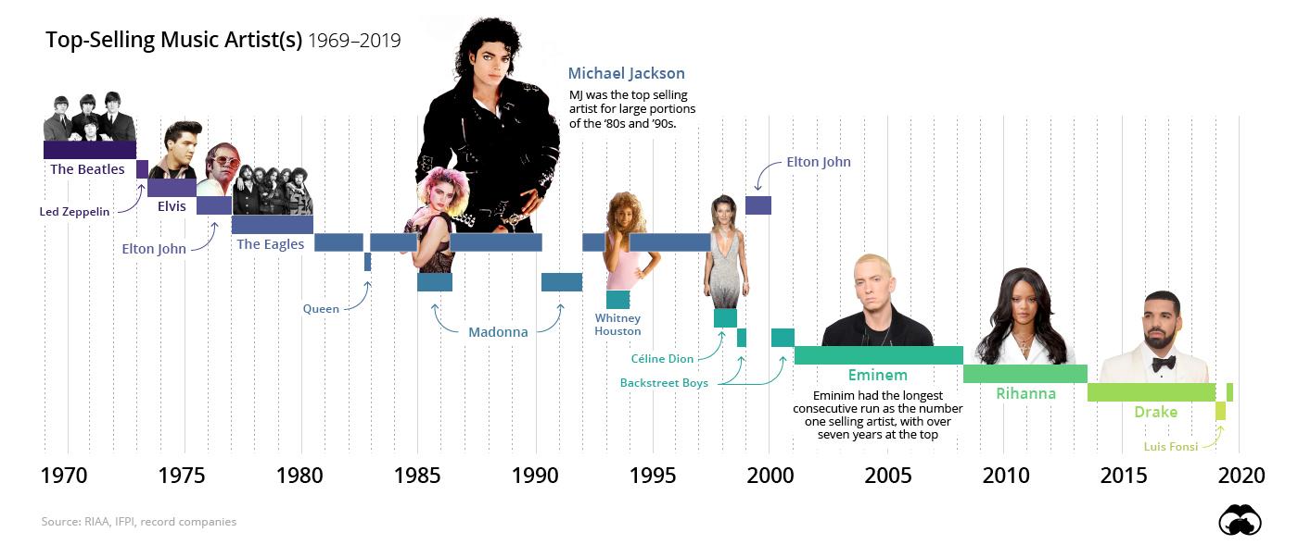
Site Name - Placeholder
Home Page
Popularity by Decade
Artist Information
Characteristic Details
Most Popular Artists (1920 – Today)
Placeholder for a text explanation of the site…
Placeholder for a text explanation of the site…
Placeholder for a text explanation of the site…

Slide 2
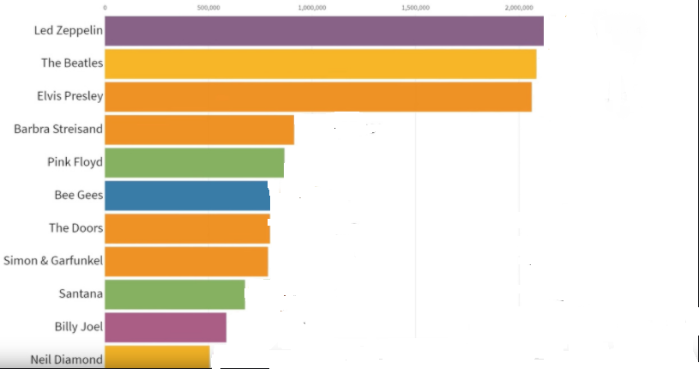
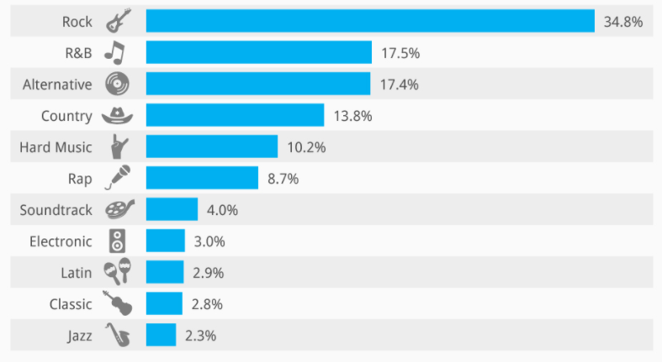
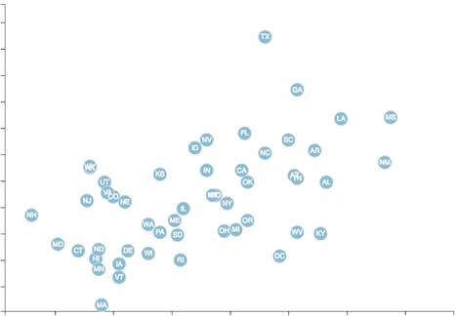
Site Name - Placeholder
Home Page
Popularity by Decade
Artist Information
Characteristic Details
Most Popular Artists by Decade
Top 10 Artists
”Top” is based on popularity column
Top 10 Songs
Decade
1970 - 1979
*Song Names should be a list/table - not a bar chart
*Y axis = # of songs
*X axis = artist name
Popularity Factors (scatter plot)
Popularity
*no data on the dots – use tooltips/popup
Danceability
Energy
Tempo

Slide 3
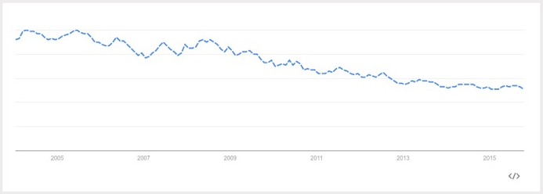
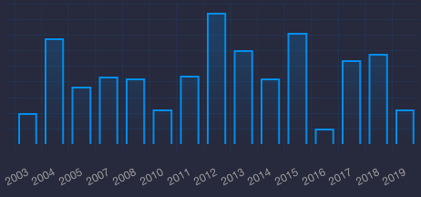
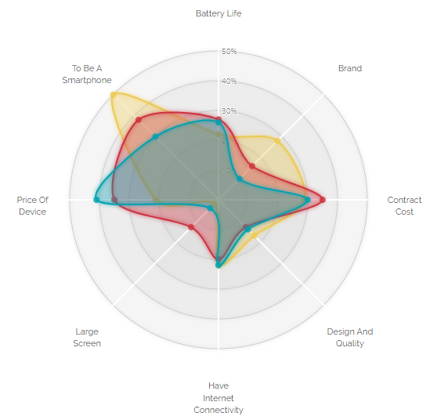
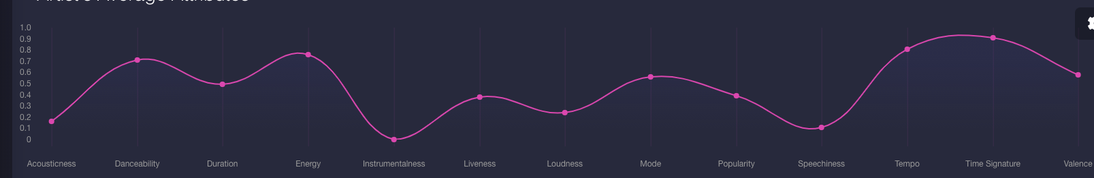
Energy
Site Name - Placeholder
Home Page
Popularity by Decade
Artist Information
Characteristic Details
Artist Information
Artist
John Doe
Tracks Released Over Time
* TBD – pick bar or line chart based on data
*x = year
*y = # of songs released by year
Track Characteristics
Song
Song Name
1 Blob – Average
1 Blob – Selected Song
* selected track characteristics

Slide 4
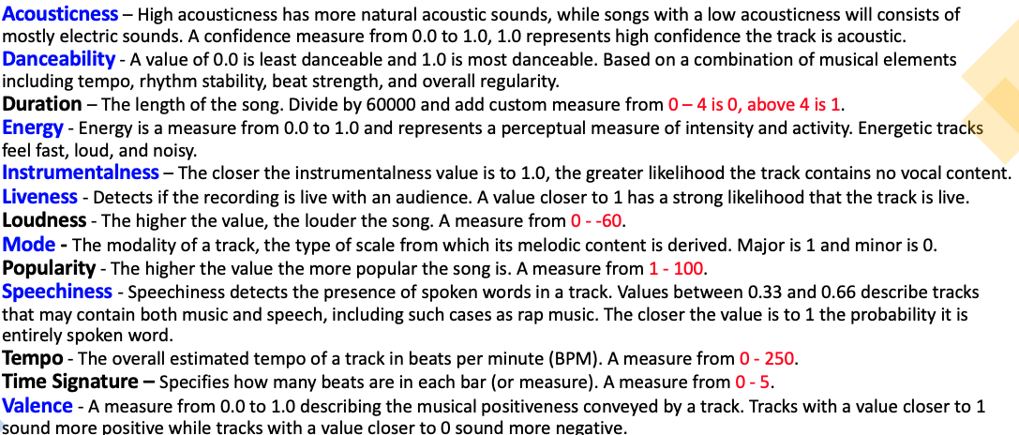
Site Name - Placeholder
Home Page
Popularity by Decade
Artist Information
Characteristic Details

Slide 5
Task List
HTML/CSS/Bootstrap – Team Effort on Saturday
Decade Charts
Dropdown - Christy
Top 10 Songs - Igor
Top 10 Artists - Germaine
Scatter Chart – Popularity vs XXX - Christy
Artist Charts
Dropdown (2) – Corey (or group effort Saturday)
# of Songs by Year (line or bar chart) - Igor
Radar Chart - Corey
Song Characteristic Chart (squiggly line) - Corey
Home Page (static image? Description text)
Characteristic Description page (Descriptive text)
CSV & Postgres Setup - Corey
Data Cleanup - Igor

